Slide 1
HUDware
Preliminary Design Review
Senior Design Project
Team 6
Fall 2016
Notes:
David

Slide 2





The Team
Paul Siqueira, Advisor
Sanghoon Lee, EE
David Meschisen, EE
Jori Platt, EE
Minwo Wang, EE
Notes:
David

Slide 3
The Issue
Augmented Reality (AR) technology is limited by obtrusive control methods
Hand gestures
Spoken commands
Physically active people find AR difficult to use
Notes:
Jori

Slide 4
Significance of the issue
Current systems:
Have limited capabilities
Require active attention
Difficult and awkward to use
AR needs to bypass these hurdles to become more practical and usable
Notes:
Jori

Slide 5
Previous Work
Google Glass ($1,500*)¹
Microsoft Hololens ($3,000)²
Recon Snow ($550)³
Personal Heads Up Display (SDP09)⁴
Notes:
Sanghoon

Slide 6
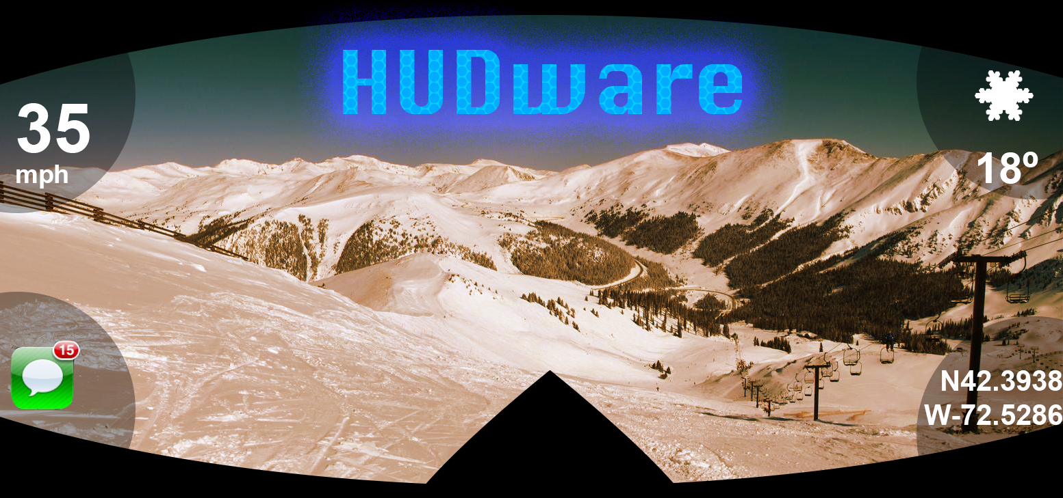
Our Solution’s Proposed Functions
Wearable Heads Up Display (HUD) Goggles
Image projection
Weather, notifications, GPS
Blink Detection
Feedback via open vs closed eyelids
Phone Application
Link with HUDware goggles
HUDware Concept Design
Notes:
Jori
-Path to conceive more sophisticated AR technology

Slide 7
Requirements Analysis: Specifications
Project image onto goggles lens
Clearly visible under normal conditions
Distraction-free display
Frequent refresh rate (at least 2 fps)
Control with Blink Detection
Quick response (within 2 seconds)
Phone Application
User-friendly Interface
Rich functionality
Durable design for activewear
Notes:
Jori

Slide 8
Requirements Analysis: Inputs and Outputs
Notes:
Jori

Slide 9




Our Solution: Simplified Block Diagram
Projection
Projector
Phone Application
Microcontroller
Camera
Blink Detection
Notes:
Minwo

Slide 10
Notes:
Minwo

Slide 11
Design Alternatives (Microcontroller)
MCU | Throughput (UART) | Computational Power | Power Consumption
Broadcom BCM2835⁵ | Very High (32 Mbps) | High (32-bit ARM1176JZF-S @ 1 GHz) | Very High (5V @ 100mA)
ARM LPC1769FBD100⁶ | Medium (6.25 Mbps) | Medium (32-bit ARM Cortex-M3 @ 120 MHz) | High (3.3 V @ 100mA)
Atmega32⁷ | Low (2 Mbps) | Low(8-bit Atmel AVR @ 16 MHz) | Very Low (3V @ .35mA)
Notes:
Sanghoon

Slide 12
Design Alternatives (Communication)
Wireless Type | Bandwidth | Distance | Complexity
Bluetooth (v4.0)⁸ | 800 Kbps | 30 feet | Pairing Devices
Wi-Fi (802.11n)⁹ | 11 Mbps | 300 feet | Accessing Internet
 | Data Production rate¹⁵
Power Comparison | 100 bytes/sec | 300 bytes/sec | 600 bytes/sec
Bluetooth (v4.0)⁸ | 15.02 mW | 15.46 mW | 16.12 mW
Wi-Fi (802.11n)⁹ | 125.67 mW | 127.01 mW | 129.02 mW
Notes:
Minwo

Slide 13
Design Alternatives (Projector)
Projector Display Type | Components | Additional Sources | Functionality
DLP TI Chipset¹⁰ | 4 | Light Source | Shine light through mirror
TOLED Display¹¹ | 1 | 0 | LED Display(Transparent)
Pico Projector¹² | 2 | 0 | Projects onto a HUD glassware
Notes:
David

Slide 14
Design Alternatives (Blink Detection)
Control Type | Software | Hardware
Blink (eyelid) detector | Quick response (0.16 seconds in Matlab) Schedulable | Camera
Motion sensor | Interrupt | Motion Sensor
Eye tracker | Complex algorithm Scheduled | Camera
Hand held control | Interrupt | System of buttons
Notes:
Jori

Slide 15
Projector (David)
Controller
Receives image data from microcontroller
LED Driver
Provides current and voltage to display received image
Display
Shines light from display to project onto lens
Notes:
David

Slide 16
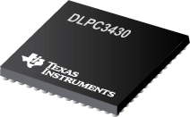
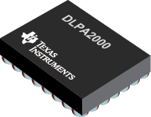
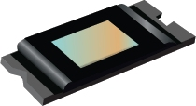
Projector (David)
DLPC 3430 (Controller)¹⁰
Video Input : 24 Bit
Max Frame Rate : 120Hz
Max Resolution : 720p
Input Pixel Clock:150 MHz
Price ~ $17.82
DLPA 2000 (LED Driver)¹⁰
V_DD = 1.8V -3.6V
Price ~ $5.12
DLP 2010 (DMD)¹⁰
Max Frame Rate : 120Hz
Max Resolution : 720p
Pixel Pitch: 5.4 𝛍m
Price ~$40.15
Notes:
David

Slide 17
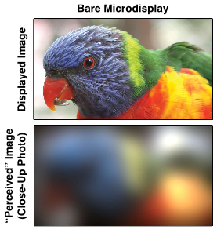
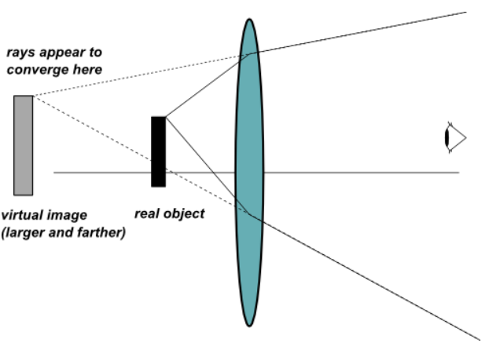
Lens Correction (Sanghoon)
Focus image for back of the eye in close distances (less than 2 inches from eye)
Differences as image is closer¹⁶
Notes:
Sanghoon

Slide 18
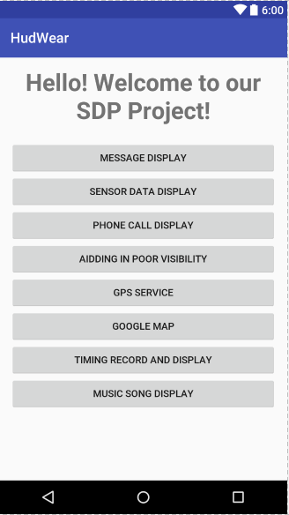
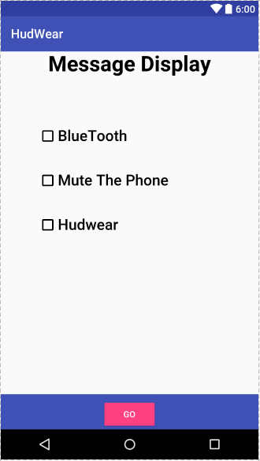
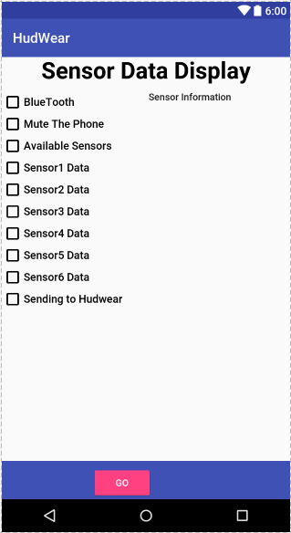
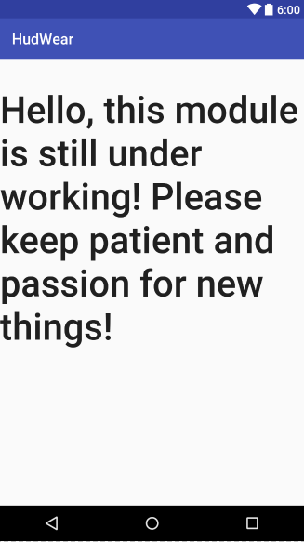
Phone App - Layout (Minwo)
Notes:
Minwo

Slide 19
Phone App - Layout (Minwo)
Notes:
Minwo

Slide 20
Phone App - Layout (Minwo)
Notes:
Minwo

Slide 21
Phone App - Layout (Minwo)
Notes:
Minwo

Slide 22
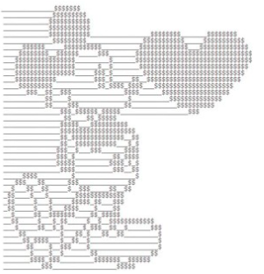

Phone App - Generate Display (Minwo)
Image Processor
Generate and send out images
Receive and decode images
Message, timing, GPS map, etc
User Interface
Source of data
Processor of the project
Notes:
Minwo

Slide 23
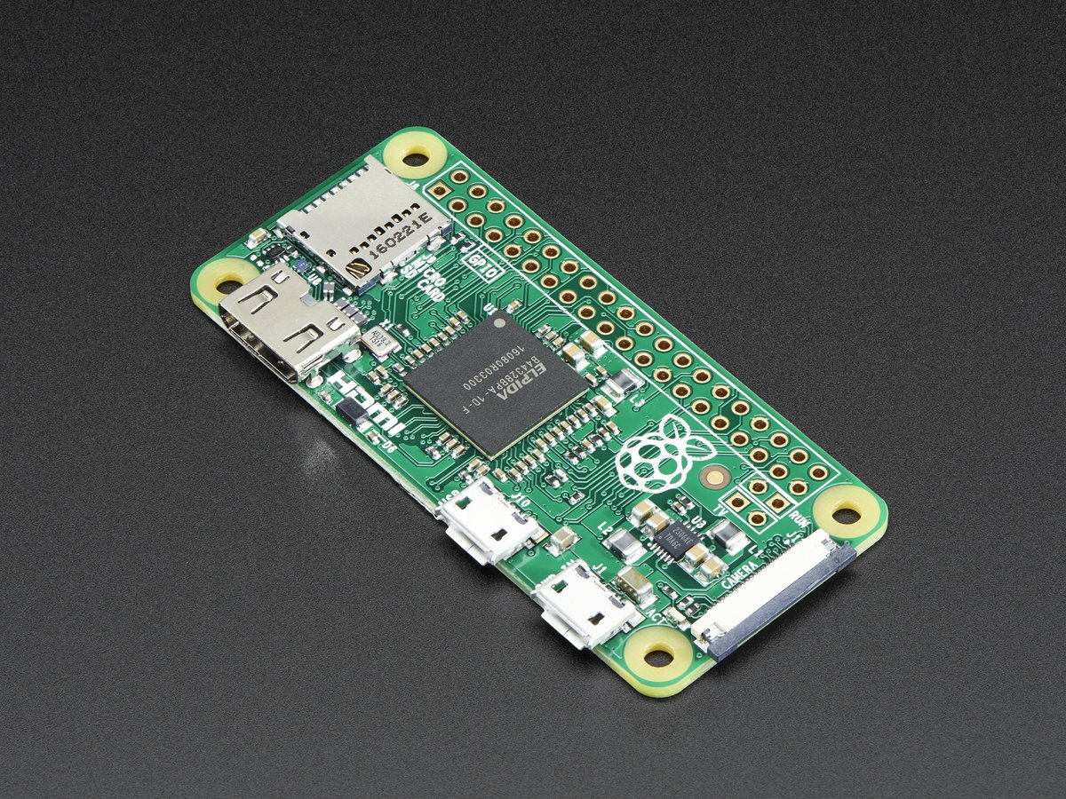
Microcontroller (MCU) (Sanghoon)
Maintains communication link
Phone, Projector, Camera
Implements scheduling
Fixed priority preemptive: process image on MCU
Drives external camera for Blink Detection
-Raspberry Pi Zero¹³
-Broadcom BCM2835 application processor with 1 GHz ARM1176JZF-S core
-512MB of LPDDR2 SDRAM
-65mm x 30mm x 5mm
-OS: Linux
Notes:
Sanghoon

Slide 24
MCU Data Transmission (Minwo & Sanghoon)
Uses Bluetooth Communication
Bluetooth (v4.0) dongle⁸
Channel Reliability
Interpolation for packets
Interrupt mechanism to throw exception
Baud/data rate set for optimal transmission
Baud rate: 9600
Notes:
Sanghoon First Bullet --- Minwo Second Bullet

Slide 25
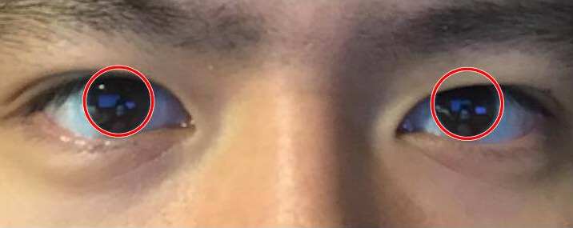
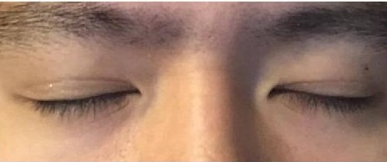
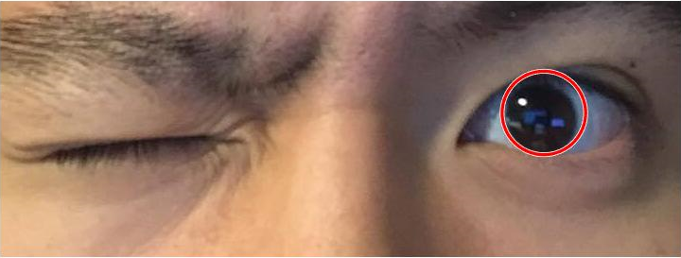
Blink Detection (Jori)
Detects closed vs open eyelids
Receives images from MCU
Low FPS
Processes image stills
Hough Circle Transform
Notes:
Jori

Slide 26
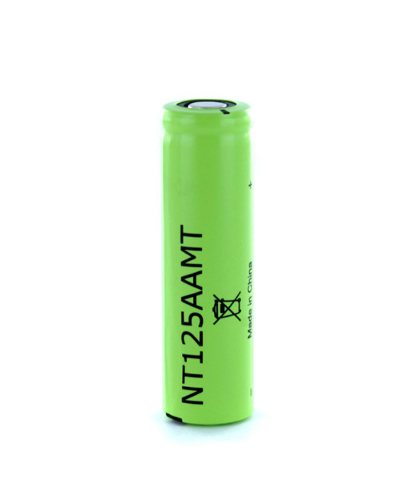
Power System (David & Minwo)
Power Source
Rechargeable battery
Needs to be compact and powerful enough for circuit
Prototyping Design
Use AutoCAD to design prototype to fit ski goggles
Small mounting type to avoid bulky size
Power System Design
Filters
Voltage Regulator
Oscillator
Raspberry Pi : 500 mAh
Ti Chipsets:
Driver: 1350 mAh
Display: 50 mAh
Controller: 120 mAh
Notes:
David First Bullet
Minwo Second Two Bullets

Slide 27
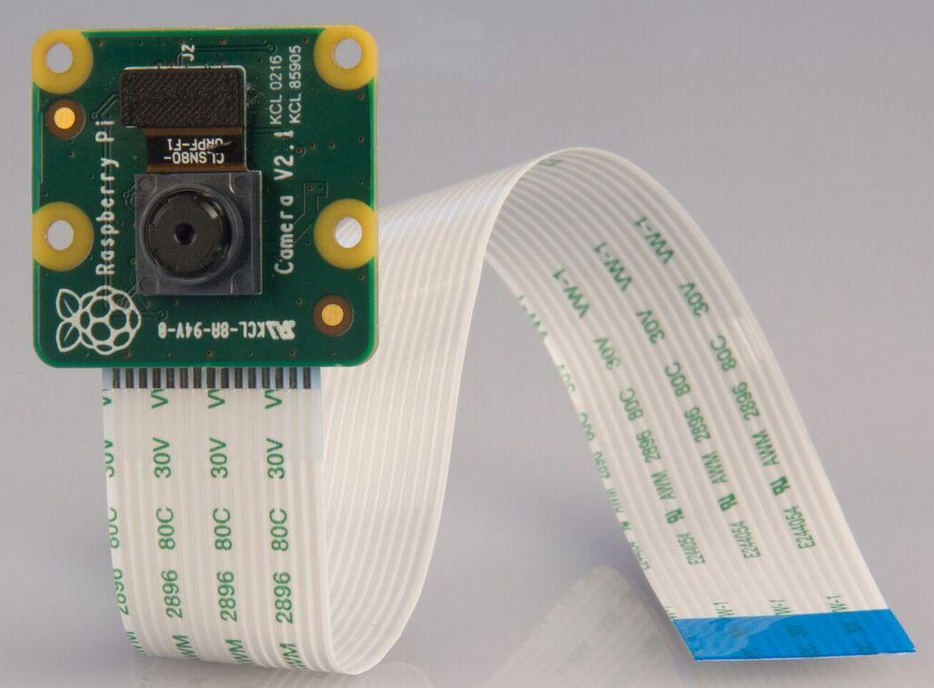
Camera Hardware (Sanghoon)
Tracks eyelid movement
Sends images to MCU at least 2 FPS
-Raspberry Pi Camera Board v2¹⁴
-8 Megapixels
-Capable of 3280 x 2464 pixels
-25mm x 23mm x 9mm
-Captures videos at 1080p30, 720p60, or 640x480p90
-Compatible with Raspberry Pi Zero
Notes:
Sanghoon

Slide 28
Addressing Several Key Concerns
Brightness
Ski goggles already darkened
Potential additional light source
Focusing
Corrective Lens
Originality
Has direct application to skiing while still being open to others
Blink Detector
Expense
Notes:
David

Slide 29
Proposed MDR Deliverables
Projector/Display assembled (12/2/2016)
Prism Construction (11/15/2016)
OLED Display Setup (11/18/2016)
App Layout and partial functionality (11/30/2016)
Blink detector code for image processing on MCU
Blink Detection code (11/15/2016)
MCU Move-In (11/20/2016)
Microcontroller communication setup and data transmission (11/10/2016)
Notes:
Sanghoon

Slide 30
Thank you!
Do you have any questions?
Notes:
David

Slide 31
References
http://www.techradar.com/reviews/gadgets/google-glass-1152283/review
https://www.microsoft.com/microsoft-hololens/en-us/development-edition
http://www.oakley.com/en/mens/goggles/snow-goggles/airwave-snow/airwave/product/WGOO7049/?skuCode=59-450&categoryCode=m030101
http://www.ecs.umass.edu/ece/sdp/sdp09/wolf/
https://www.raspberrypi.org/wp-content/uploads/2012/02/BCM2835-ARM-Peripherals.pdf
http://www.nxp.com/documents/data_sheet/LPC1769_68_67_66_65_64_63.pdf
http://www.atmel.com/Images/doc2503.pdf
https://www.adafruit.com/product/1327
https://www.adafruit.com/products/814
http://www.ti.com/lsds/ti/analog/dlp/getting-started.page#what-is-in-chipset
http://www.4dsystems.com.au/product/uTOLED_20_G2/
http://www.aaxatech.com/products/p4_pico_projector.htm
https://www.adafruit.com/product/2885
https://www.adafruit.com/products/3099
Balani, Rahul. Energy Consumption Analysis for Bluetooth, WiFi and Cellular Networks (n.d.): n. pag. University of California, Los Angeles. Web. <http://nesl.ee.ucla.edu/uploads/document/paperupload/254/PowerAnalysis.pdf>.
Lanman, Douglas, and David Luebke. "Near-eye Light Field Displays." ACM SIGGRAPH 2013 Talks on - SIGGRAPH '13 (2013): n. pag. NVidia. Web. <https://research.nvidia.com/sites/default/files/publications/NVIDIA-NELD_0.pdf>.
Texas Instruments. "DLP ® Technology for Near Eye Display." Whitepaper (2014): n. pag. Web. <http://www.ti.com/lit/wp/dlpa051/dlpa051.pdf>.

Slide 32
Backup Slides

Slide 33
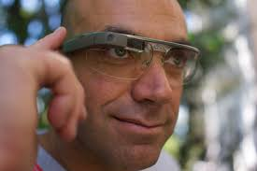
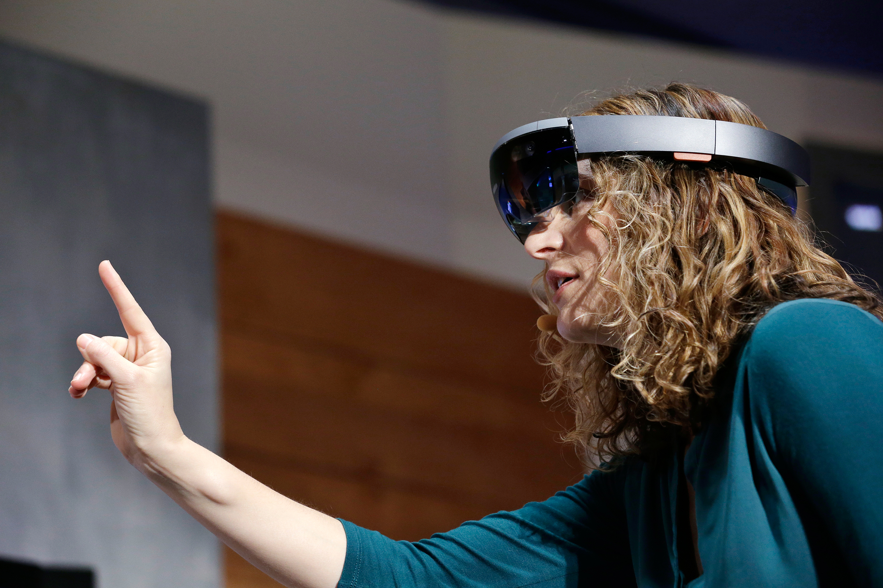
Previous Work
Google Glass ($1,500*)
Voice commands and side touch controller
Microsoft Hololens ($3,000)
Requires hand gestures
Can get confused by objects in close proximity
Recon Snow ($550)
Dashboard vs AR
No feedback control
Google Glass
Microsoft Hololens
Notes:
Sanghoon

Slide 34
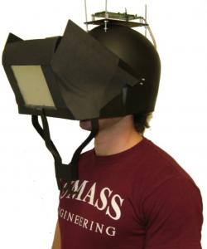
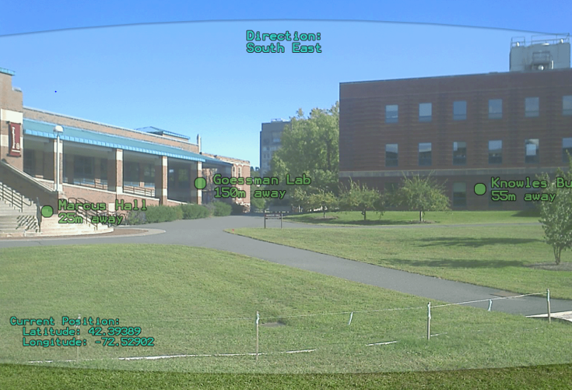
Previous Work (SDP09)
Personal Heads Up Display
Go beyond building labeling function
Reduce weight and size
Personal Heads Up Display Helmet⁴
Notes:
Sanghoon

Slide 35
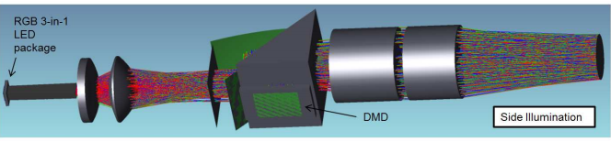
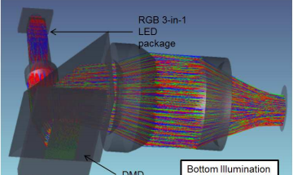
TI Chipset Optics

Slide 36
Passive Matrix Transparent OLED Display
Transparent LED display
2.4” displays, one for each side of the goggles
Acts as a filter for sunlight by being 60-90% transparent

Slide 37
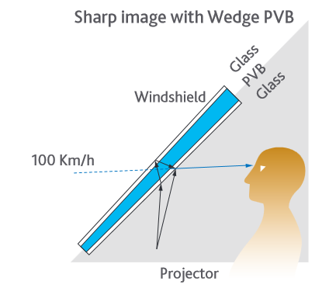
Eastman Chemical Company Laminate
Used for automotive HUD
Acoustic Polyvinyl Butyral (PVB) wedged interlayer between 2 angled layers of glass

Slide 38
Blink Detector
Small fps should be enough for feedback system
Speed depends on computation time
Sensitivity calibration
Currently .955 for Sanghoon and Minwo
.975 for Jori likely due to image quality
Circle Detector
Currently finding best process via matlab
Will switch process to either Pi or App

